Slide 1






Richard Macintyre
Director of Quality and Innovation
Reaching into Communities
TLAP Conference
22 February 2018

Slide 2

Todays Presentation
___________________________
About Me
Background to Friends of the Elderly
Our Vision, Mission and Aims
Older People Living in the UK
Consequences of the UK Ageing Population
Skills for Care Workforce Report (2017) +
Timeline: SCIE Research Project
Our SCIE Objectives
What is Community Asset Mapping?
Pilot Sites Woking
SCIE Methodology & 7 Phases of Research
Pilot Progress to Date
Case Histories
Questions?

Slide 3
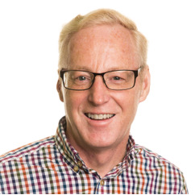
About Me:
Richard Macintyre B.Sc (Hons)
Director of Quality and Innovation
Current post since 2016
Involved in Health and Social Care over many years
Hold a Registered Nurse and clinical qualification (Orthopaedics, District Nursing) + Certificate in Management and Practice Teaching
Worked with a range of service user groups, Ex Armed Forces, Mental Health and Palliative Care
Held a number of posts e.g. Head of Housing (RBLI), Regional Care Director (Avante Care and Support)
Passionate about the care of older people - Dementia type conditions, Mental and Physical Health
Author of several published articles and a handbook for families about Dementia
Outside Interests:
Living life to the full:
Climbed Mount Everest - 2009
24 Peaks in 24 hours - 2015
Paramotoring - April 2018
Advice to my younger self :
Be yourself, be mindful always and support your family and close friends
Life’s a Journey – Enjoy the ride !

Slide 4
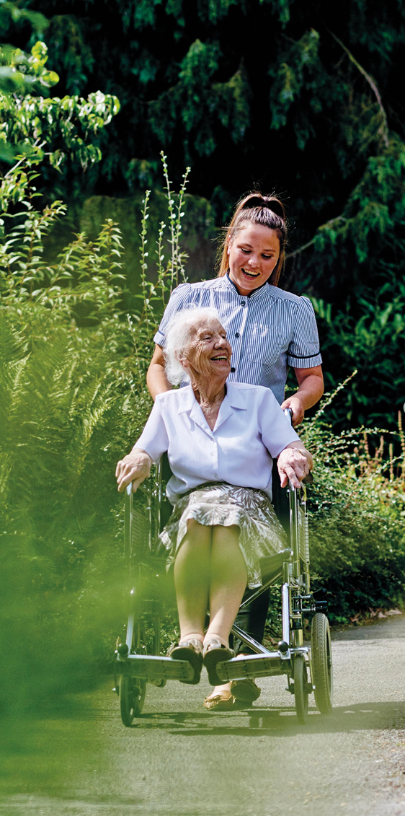
Background to Friends of the Elderly
Registered charity
112 years old (1905 – Church Army League of Friends of the Poor)
1972 - became Friends of the Elderly
£30m income
We employ 1,000 staff
We have 22 services, 18 Regulated and 4 Day Centres
Services throughout England
14 care homes - nursing and residential
We care and support for over 1500 older people
We have a 5 year strategy (which includes IoT)
We provide Home Care Services
We also provide a voluntary visiting services, fundraising and grant giving
Our Patron - HM The Queen
Our President – HRH Princess Alexandra
We are based in Belgravia SW1 at 40-42 Ebury Street

Slide 5
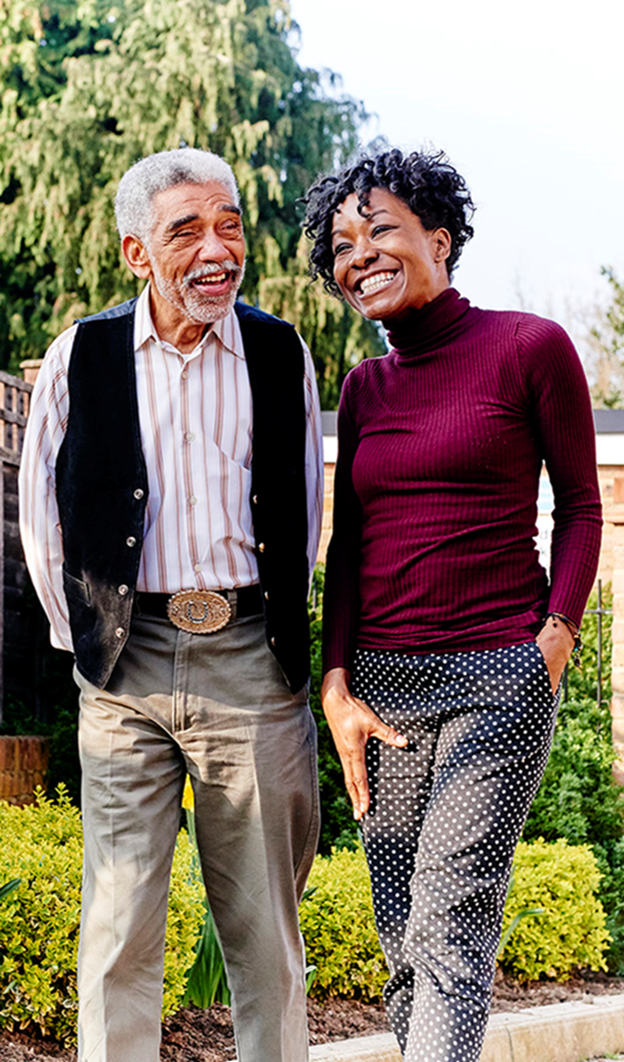
Our Vision, Mission and Aims
Our Vision:
We aspire to a society where all older people have the opportunity to live fulfilled lives.
Our Mission:
We will do this by delivering services personalised to individual needs and integrated with local communities.
Our Strategic Aims:
To ensure older people have access to safe, high quality care and support services.
To ensure older people in our communities have access to social support, activity and opportunities.
To increase the wellbeing of older people in our communities and help alleviate loneliness and isolation.
To operate services sustainably and ethically to safeguard the charity’s legacy, and its future.

Slide 6
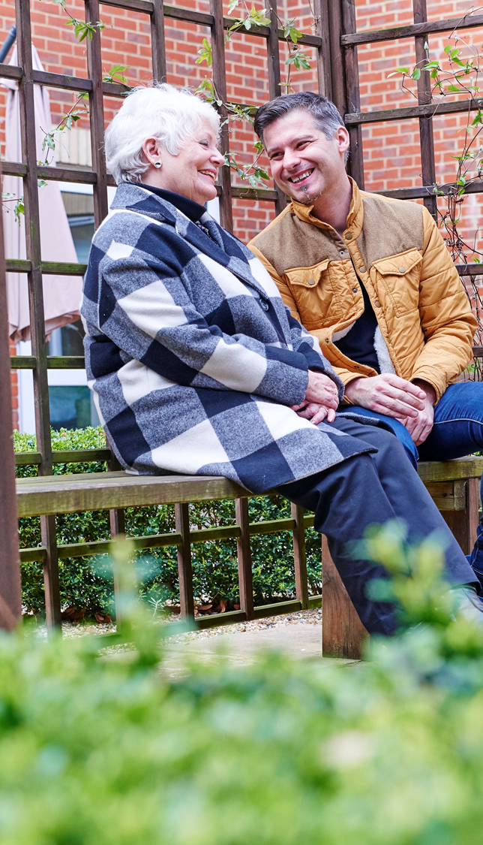
Older People Living in the UK
Current UK total population is 66 million
UK total population will increase to 70 Million + by 2026
The population of 65 year olds and over represents 17.8% of the current population
By 2045 (28 years) older people will represent 24.6% a quarter of the population
Current people aged 100 or over in 2016 14,910
Increase in life expectancy is due to improved Healthcare
1960 Baby Boomers and Echo of Baby Boomers in 2012 peaked at 813,000 - new births
Life expectancy :
Girls born in 2015 are expected to live 82.8 years
Boys born in 2015 are expected to live 79.4 years
Migration to UK in 2015 was 631,500

Slide 7

Consequences of the UK ageing population
Older people over 65 are living longer
Working age population will be needed to support older pensioners
In 2016 it was estimated 308 people of pensionable age for every 1000 people of working age
Projections are this will increase by 19% (365) by 2037 for every 1000 people of working age
Lower birth rates and higher life expectancy of older people from 2017
Working age population will decrease
Sustainability pressure on Social and Health Care Services including the Independent and Charitable Sector (Green Paper Summer 2018)
Comorbidity of older people including Dementia type conditions 850K in 2017 (estimated to be 2 Million
by 2051)
Lack of professional cares and health professionals (GPs, DN, OTs plus others)
Reduction of a care workers due to societies low value and pay rates of the sector workforce
Government under pressure to reduce costs of Health and Social care to NHS and Local Authorities

Slide 8


Presentation Title, May 2015
Skills for Care: Workforce Sector Report (2017) +
Nationality of care workers 83% British, 7% EU (10% for FotE), 9% non EU.
18% Male 82% Female
1.58 million jobs across 40,000 plus care locations in the UK
350,000 leaving their role per annum (turnover = 27.8%)
90,000 vacancies at any one time for the sector
Number of people applying to train as a nurse has fallen for second Year
Nursing Degree applications have fallen by 23% (Nursing Times)
20% of workers aged 55 or over (305,000)
7% (95,000) workers from the EU
Care worker (independent sector) median pay = £7.76 per hour
Projection growth of an additional 500,00 jobs by 2030

Slide 9
SCIE Research Project: Reaching into communities
Timeline:
SCIE agreed to undertake a research project - (Jan 17)
Review Good Practice (Jan – Mar 17)
In depth Interviews with LA’s, CCGS, Service Managers and Commissioners (Jan –Feb 17)
Focus Group with Friends of the Elderly Service Users
( Feb 17)
Commence community asset mapping workshop
( Feb 17)
Presentation to FotE Board of Trustees (Mar 17)
Workshop for Service Mangers for pilot site Woking to discuss opportunities and challenges ( 8 Jun 17)
Rollout of community mapping workshops to other sites (ongoing)

Slide 10
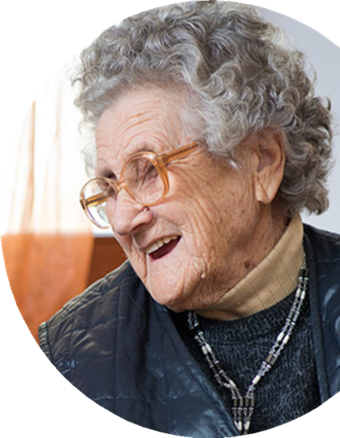
Presentation Title, May 2015
Our SCIE Objectives:
To inform FotE’s long term strategy to develop services and invest in resources
Explore the feasibility of developing FotE’s existing services to a wider community with the potential to build on community assets
Identify a chosen site: (Bernard Sunley Care Home and the Bradbury Centre Woking)
Undertake a community asset based mapping exercise to explore the potential and opportunities to develop services to wider community
Review best practice and develop integrated community care services

Slide 11

Presentation Title, May 2015
What is Community Asset Mapping?
Every community has a range of assets, relationships and networks
An asset based approach values the capacity, skills, knowledge, connections and potential in the community. It challenges traditional thinking and sees what works well in a local area rather than problems. For example:
  Personal assets knowledge, skills, talent & aspiration
  Social assets, relationships and connections people have with friends and relatives, families & peers
  Community assets e.g. Voluntary Sector Organisation (VSO) associations and clubs
  Neighbourhood assets: physical places and buildings that contribute to health and wellbeing such as parks, libraries and leisure centres

Slide 12

Bernard Sunley Nursing Home
Woking Pilot Site - Location Map
The Bradbury Centre Including: Triangle Day Care Woking, Triangle Home Care Woking & Visiting Friends Offices

Slide 13
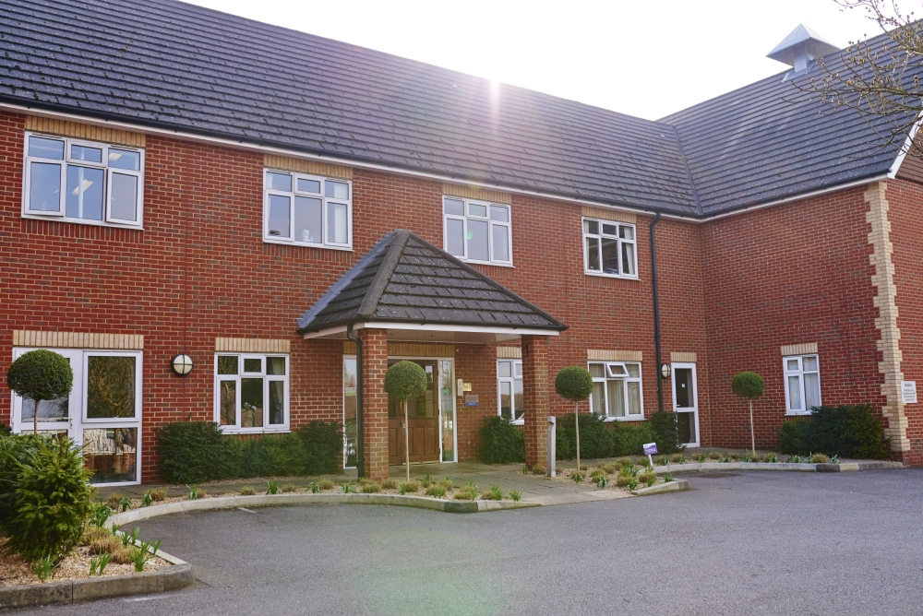
Presentation Title, May 2015
Pilot Sites Woking
Bernard Sunley Nursing Home, College Road, Maybury, Woking, Surrey
Purpose built 62 bed care home opened in 2001
Providing residential, nursing & dementia care in a secure, friendly environment
All rooms are en-suite and personalised by the residents
Built around two internal courtyards with conservatory and raised flower beds
Spacious, light and airy spaces both
indoor and outside
A welcoming café
A relaxed homely atmosphere
Provides positive supportive activities
linked to other onsite services

Slide 14
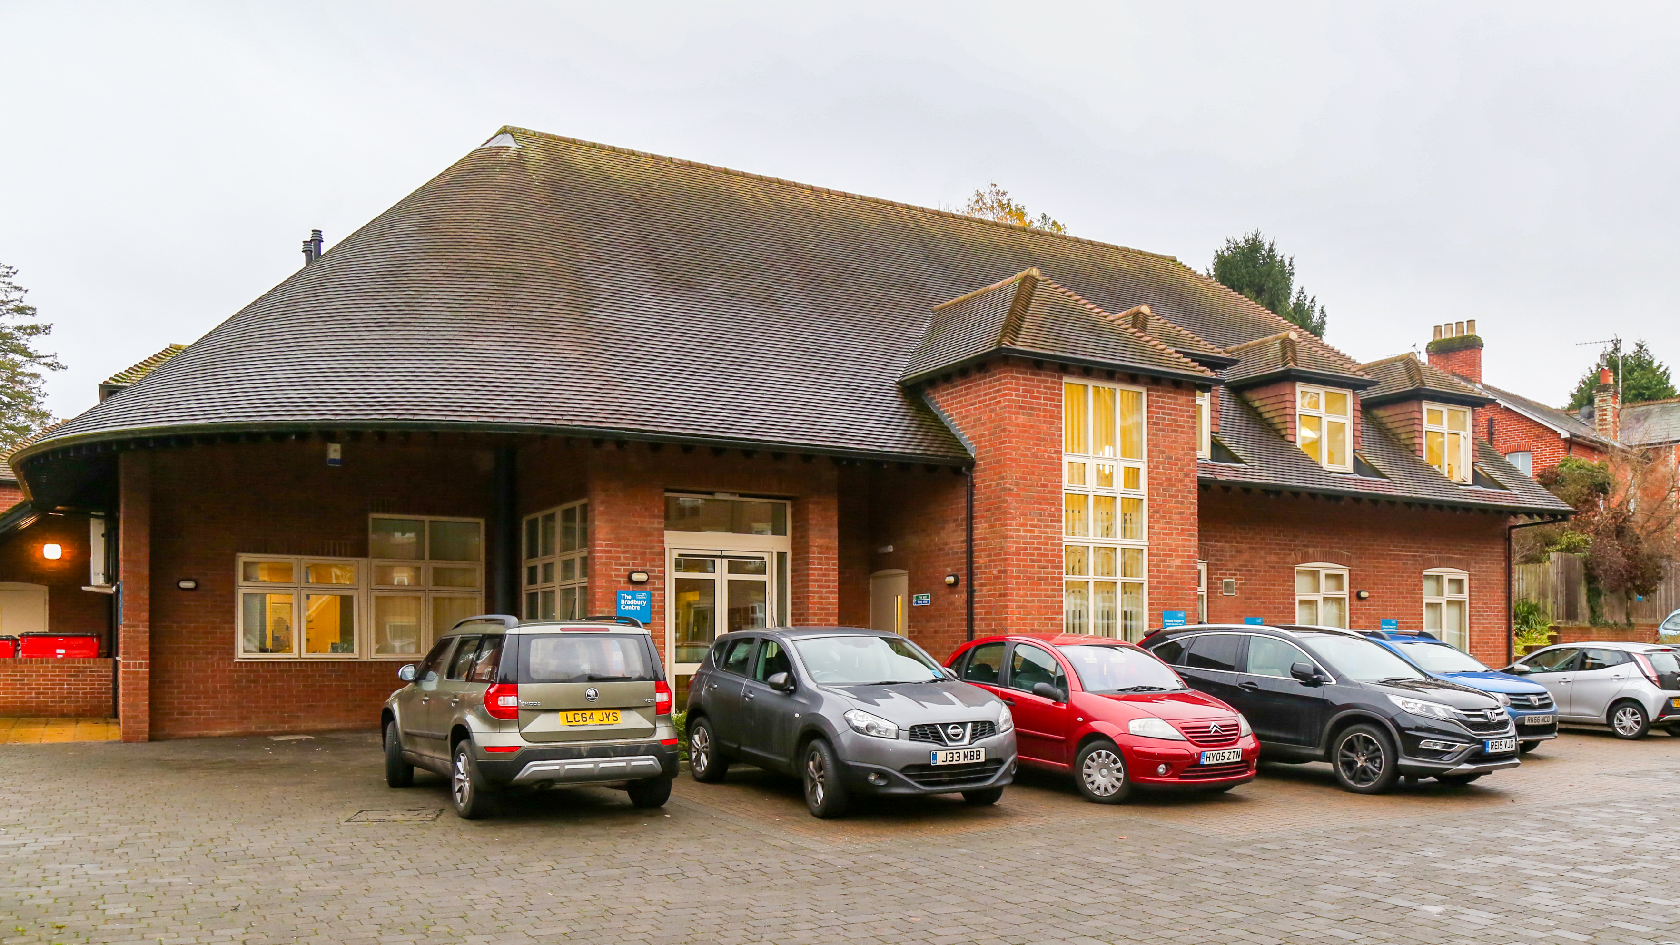
Presentation Title, May 2015
Pilot Sites Woking
The Bradbury Centre, Smiles Place, Lavender Road, Woking, Surrey
A purpose built community services building opened in 2005
Services provided from this site include:
  Triangle Day Care – Open 6 days a week, offering 26 places per day. Service includes a centre for younger and older people with dementia type conditions
  Triangle Home Care - providing 1400 hrs of care per month to 58 service users living in the Woking Borough an expanding service
  Visiting Friends Woking – 32 volunteers providing 2076 of hours of support to 191 number of older people in the Woking area
  Office base for the Director of
  Integration & Community
  Engagement Manager

Slide 15

Presentation Title, May 2015
SCIE Methodology – 7Phases of Research
Project start up and review of Good Practice
In depth Preparatory Interview
Focus Group with residents and relatives
Asset based Workshop Reporting
Preparation of findings to the Board
Workshop with Service Managers at Pilot site Woking
Roll out of Community Asset Mapping Workshop in other sites

Slide 16

SCIE: Methodology Phases 1-7
Phase 1. Project start up and review of Good Practice approaches
Identify & Involve the Bernard Sunley Care Home and the Bradbury Centre as the pilot of the project
Review recent literature and aim of identity trends in asset based approaches to care provision – examples of good practice
Detail planning of the asses based workshop
Phase 2. In depth preparatory Interviews
In depth Interviews with 5 Commissioners, Service providers and Voluntary Sector Organisations in the Woking area
Explore view on local assess and assess gaps and opportunities
Visit Bernard Sunley and Bradbury Day Centre to interview Service Managers and Activities Co-ordinators
Phase 3. Form a focus group of residents and relatives
Explore views on their own assets and believed existed
locally and procured opportunities to engage the local
community

Slide 17
SCIE: Methodology Phases 1-7 Continued…
Phase 4. Asset Based workshop and Reporting
SCIE and David Russell from SPICE a leading expert on asset based approaches, facilitated a workshop
18 people took part plus local council representatives, CCG, Housing Association, the voluntary and Community Sector to improve live in care homes
The workshop mapped out local community assets and developed points of action
Phase 5. Presentation of findings to FotE Board – March 2017
The findings were presented to the Board of Trustees with agreement to proceed with a full pilot project at Woking
Phase 6. Workshop for Service Managers at Woking
Workshop with Service Managers to present findings and research and to discuss opportunities and challenges it presents
Phase 7. Rollout of Community Asset Mapping to other sites
Ongoing plans to replicate the research and Workshops to other Care Homes and Service locations.

Slide 18

Presentation Title, May 2015
The pilot progress to date…..
How has the pilot provided better outcomes for the people of Woking?
It’s early days as the pilot has only been going for 6 months
The breaking down of Silos for the Care Home and Bradbury Centre!
The Care Home and the Bradbury Centre have joint meetings
The Activities Co-Ordinator within FotE are taking part in NAPPA training courses which involves community engagement
Change of mind set FotE staff at the Care Home and Bradbury Centre
Visiting Friends Volunteer Services visit the Care Home and get involved with activities
Local housing associations are invited to take part in activities

Slide 19
Presentation Title, May 2015
The pilot progress to date (Cont)…..
Communities within this area have become more open and involving
Appointment of the Engagement Manager (Jan 19) to work across both sites and community services
Regular meeting with SCIE to discuss how progress is being made using a theme approach
Involvement of local groups, churches & local voluntary organisations
The Care Home has a regular event for Mothers and Toddlers and now provided baby changing facilities and play areas for children
Transport is a challenge still and one major concern being explored
From April 18 a Community Volunteer Connector is being appointed & funded by Woking council to work with older people on a one to one basis to connect them with local facilities

Slide 20

Presentation Title, May 2015
Case History 1. – Triangle Community Services
A service user of Triangle Home Care Woking Branch was under the care of the NHS Mental Health Team for a mental health condition. This person had no confidence, low self-esteem, would not go out, was very isolated in her community and very lonely
Through the Visiting Friends project we put them in touch with our Day Centre and the volunteer visited on a regular basis to form a friendship
Overtime the service users confidence improved
The Service User become more outgoing, made friends with her those at her community
Took part in activities
No longer cared for by the Mental Health Team
Now has reduced the medication being taken

Slide 21
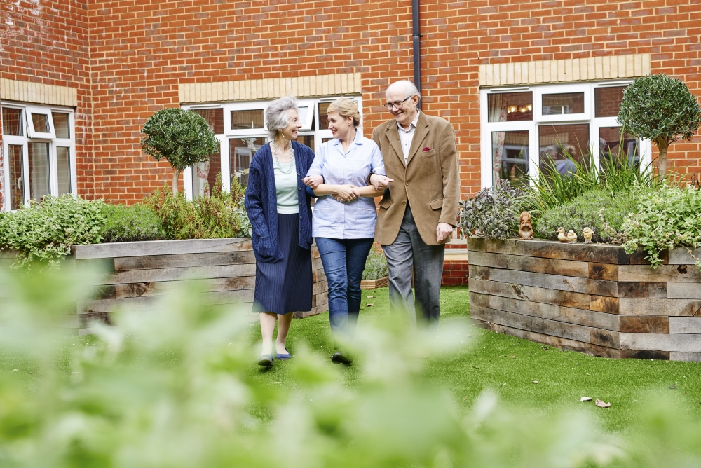
Case History 2 – Bernard Sunley Care Home
A service user of the Triangle Day Care was referred to Bernard Sunley Care Home.
The family were increasingly concerned that their relative was becoming at risk through her dementia type condition advancing while living at home.
The family were impressed with how their relative has settled into the home so quickly, and still continues to attend Triangle Day Care Woking on a weekly basis keeping in contact with friends from the Day Centre.
She has also made many new friends and enjoys trips out with activities organised through the Visiting Friends Service which is also based at the Bradbury Centre.

Slide 22


Thank you and any Questions?
richard.macintyre@fote.org.uk

Slide 23

References:
Friends of the Elderly : Values and Missions and Aims (2016)
SCIE Reaching into communities: Research to explore the potential for a different Friends of the Elderly community offer (2017)
Skills for Care: The state of the adult social care sector and workforce in England (2017)
Nursing Times: Applicants for nursing courses fall for second year running since scraping the student bursary (2018)

